Slide 1
Globalization and World Trade
Alan V. Deardorff
University of Michigan
For presentation at
Institute of Retired Professionals
June 27, 2018

Slide 2
Outline
What is (or was?) globalization?
Causes and effects of globalization
Trade imbalances
Policy responses

Slide 3
What is (or was?) globalization?
Growth of international trade

Slide 4
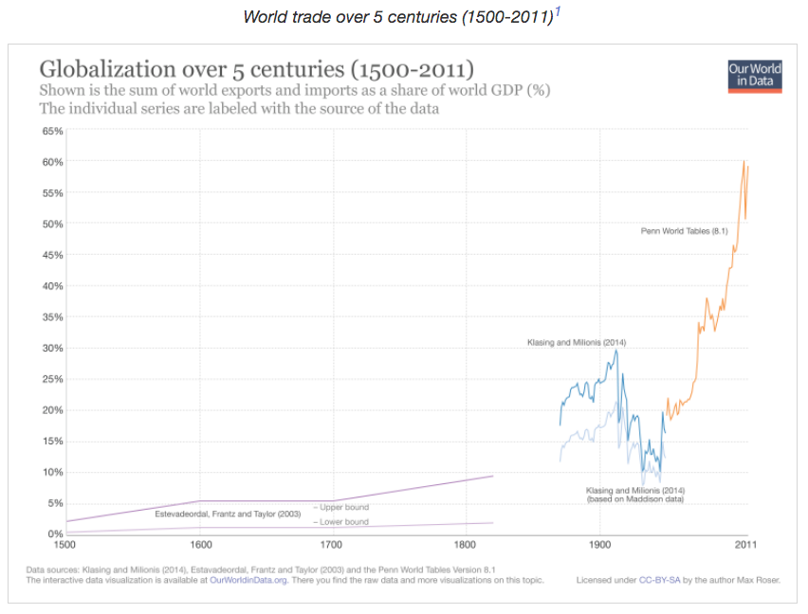
Notes:
Esteban Ortiz-Ospina and Max Roser (2018) - "International Trade". Published online at OurWorldInData.org.
Retrieved from: 'https://ourworldindata.org/international-trade' [Online Resource]

Slide 5
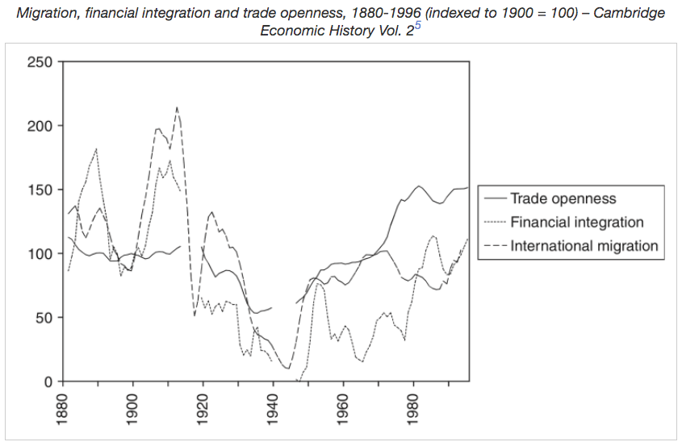
What is (or was?) globalization?
Growth of international trade

Slide 6
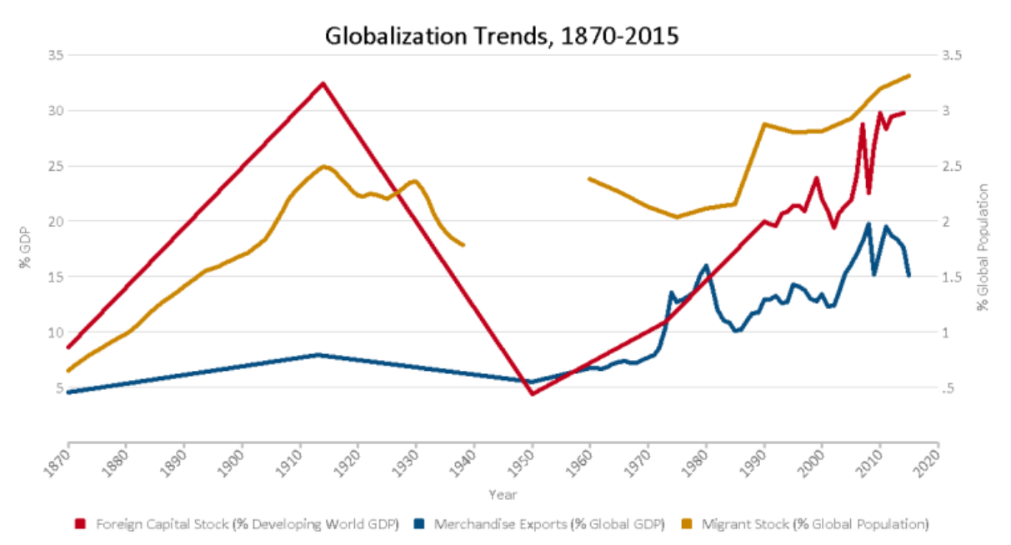
Notes:
Laurence Chandy and Brina Seidel, “Is globalization’s second wave about to break?,” Brookings, October 4, 2016.
https://www.brookings.edu/research/is-globalizations-second-wave-about-to-break/

Slide 7
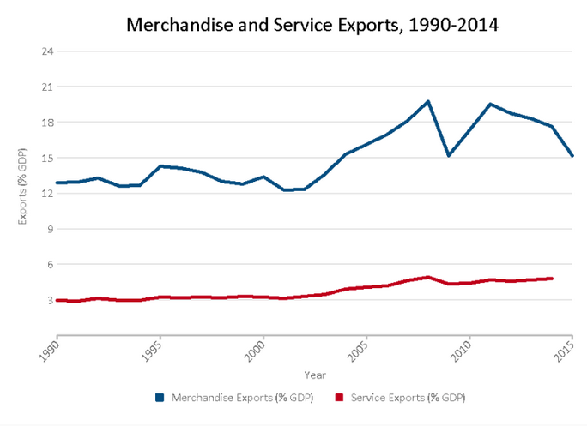
Notes:
Laurence Chandy and Brina Seidel, “Is globalization’s second wave about to break?,” Brookings, October 4, 2016.
https://www.brookings.edu/research/is-globalizations-second-wave-about-to-break/

Slide 8
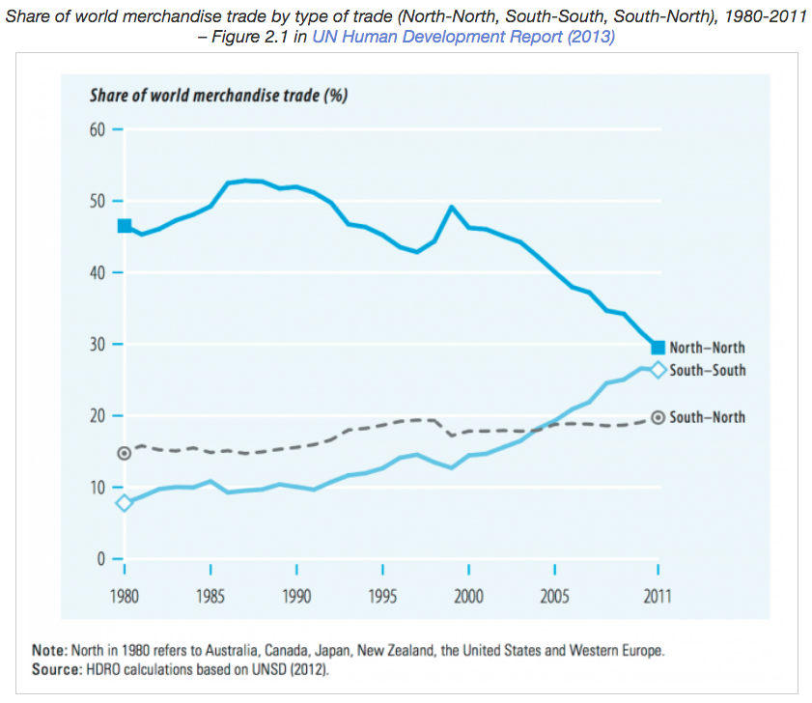
Notes:
Esteban Ortiz-Ospina and Max Roser (2018) - "International Trade". Published online at OurWorldInData.org.
Retrieved from: 'https://ourworldindata.org/international-trade' [Online Resource]

Slide 9
What is (or was?) globalization?
Growth of international trade
Growth of international investment

Slide 10
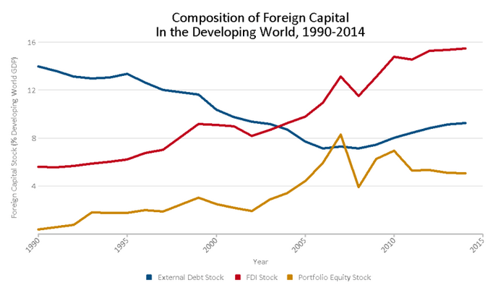
Notes:
Laurence Chandy and Brina Seidel, “Is globalization’s second wave about to break?,” Brookings, October 4, 2016.
https://www.brookings.edu/research/is-globalizations-second-wave-about-to-break/

Slide 11
What is (or was?) globalization?
Growth of international trade
Growth of international investment
Growth of international financial transactions

Slide 12
What is (or was?) globalization?
Growth of international trade
Growth of international investment
Growth of international financial transactions
Growth of international supply chains

Slide 13
What is (or was?) globalization?
Growth of international trade
Growth of international investment
Growth of international financial transactions
Growth of international supply chains
Growth of international migration?

Slide 14
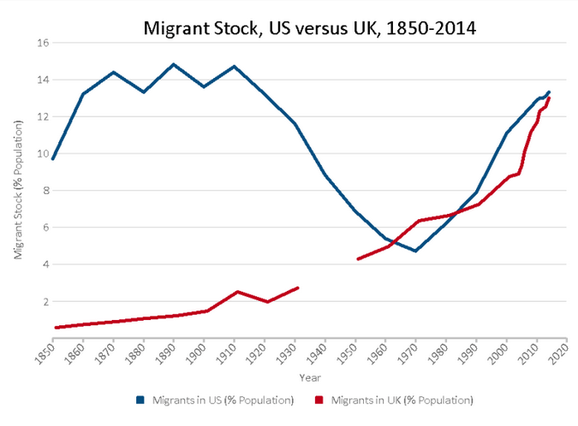
Notes:
Laurence Chandy and Brina Seidel, “Is globalization’s second wave about to break?,” Brookings, October 4, 2016.
https://www.brookings.edu/research/is-globalizations-second-wave-about-to-break/

Slide 15
Causes and Effects of globalization?
Reduced
Trade costs
Tariffs
Economic growth
Inequality?
Attitudes

Slide 16
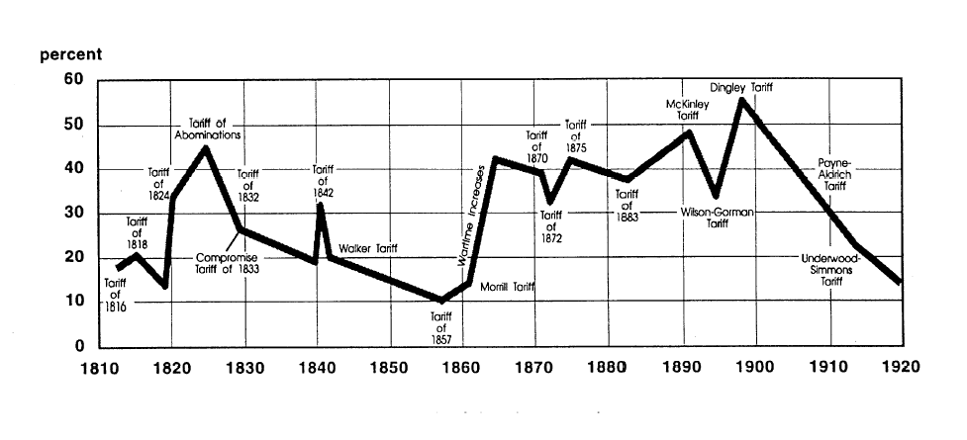
US tariff history: 1810-1920
Today
Notes:
Source: landandfreedom.org

Slide 17
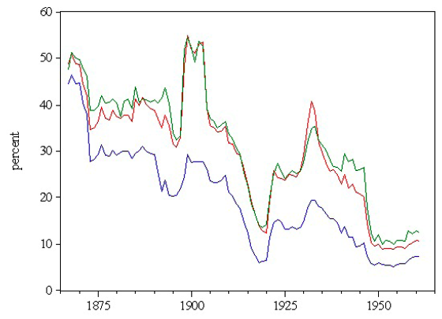
US tariff history: 1865-1960
Average tariff
Today
Today
Notes:
Source: Irwin, Doug, “Trade Restrictiveness and Deadweight Losses from U.S. Tariffs,” 22 December 2008, Figure 1.

Slide 18
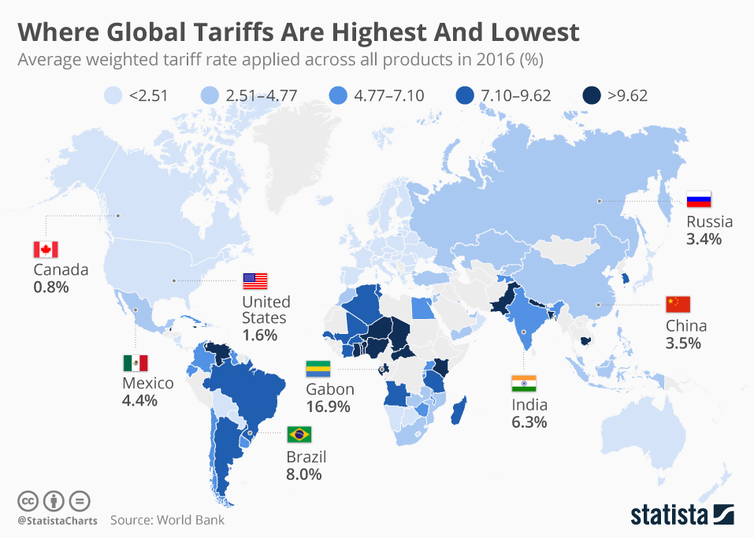

Slide 19
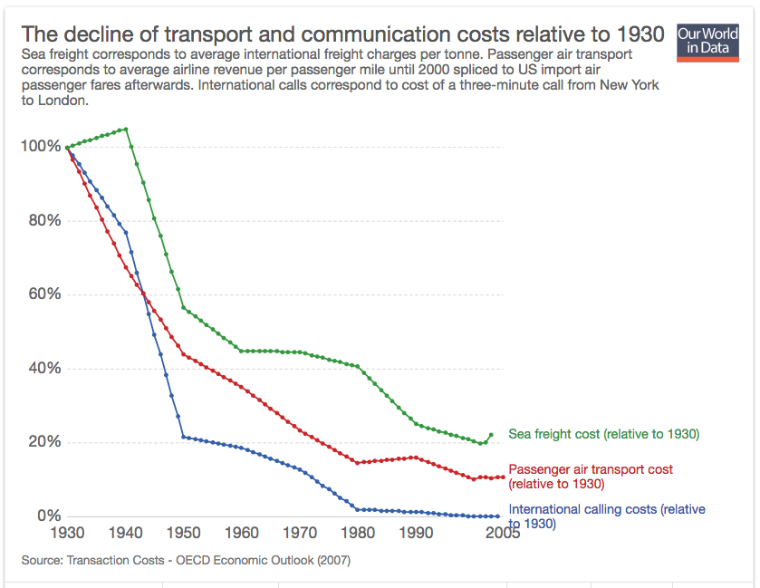
Notes:
Esteban Ortiz-Ospina and Max Roser (2018) - "International Trade". Published online at OurWorldInData.org.
Retrieved from: 'https://ourworldindata.org/international-trade' [Online Resource]

Slide 20
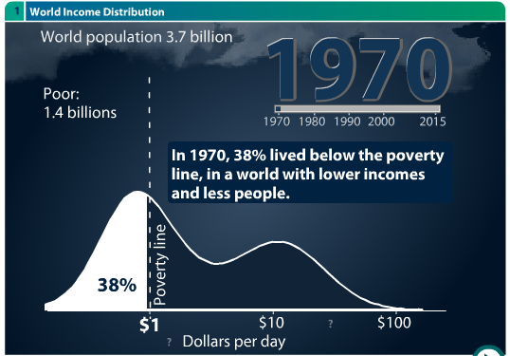
Data from Gapminder.org

Slide 21
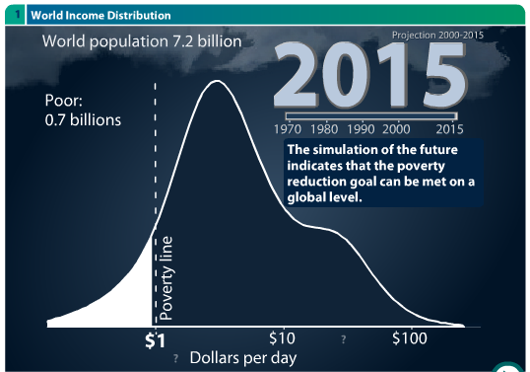
Data from Gapminder.org

Slide 22
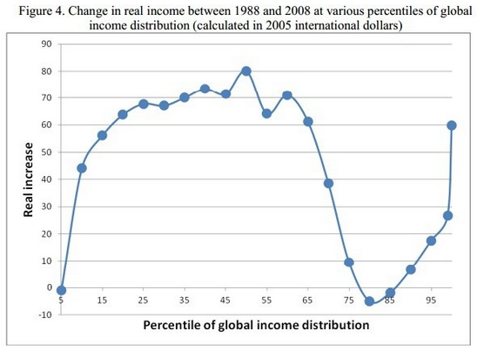
Notes:
Stéphanie Thomson, “People are angry about globalization. This chart explains why,” World Economic Forum, July 11, 2016.
https://www.weforum.org/agenda/2016/07/people-are-angry-about-globalization-this-chart-explains-why/

Slide 23
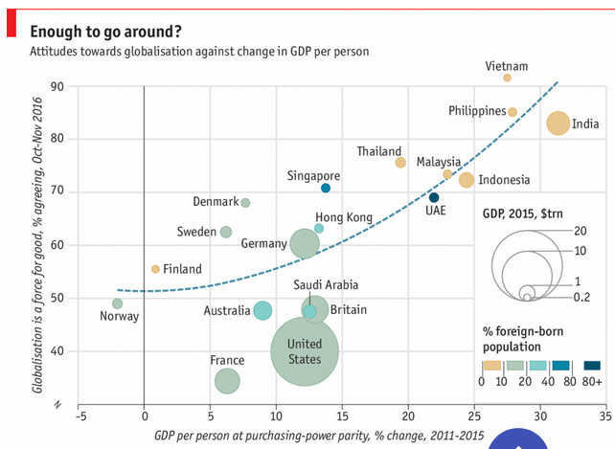
Notes:
Economist, “What the world thinks about globalization,” Nov 18th 2016.
https://www.economist.com/graphic-detail/2016/11/18/what-the-world-thinks-about-globalisation

Slide 24
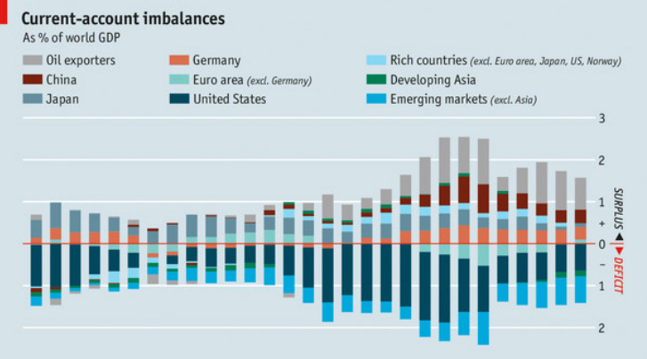
Trade Imbalances

Slide 25
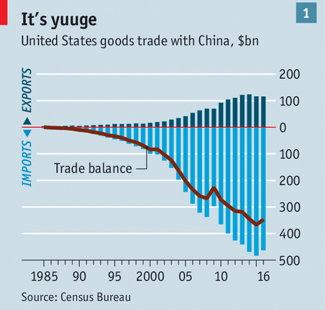
Trade Imbalances
Notes:
Economist

Slide 26
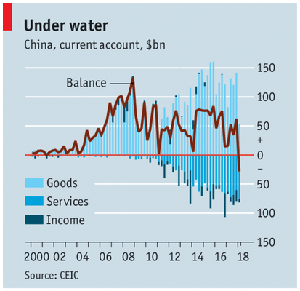
Trade Imbalances
Economist
Notes:
Economist, “China’s vanished current-account surplus will change the world economy,” May 17, 2018.
https://www.economist.com/finance-and-economics/2018/05/17/chinas-vanished-current-account-surplus-will-change-the-world-economy

Slide 27
Trade Imbalances
What they mean
M-X > 0
Buying more than producing
Spending more than earning
What they do not mean
Losing jobs
Being taken advantage of

Slide 28
Policy Responses
Until recently
Efforts to encourage globalization
FTAs
Trans-Pacific Partnership

Slide 29
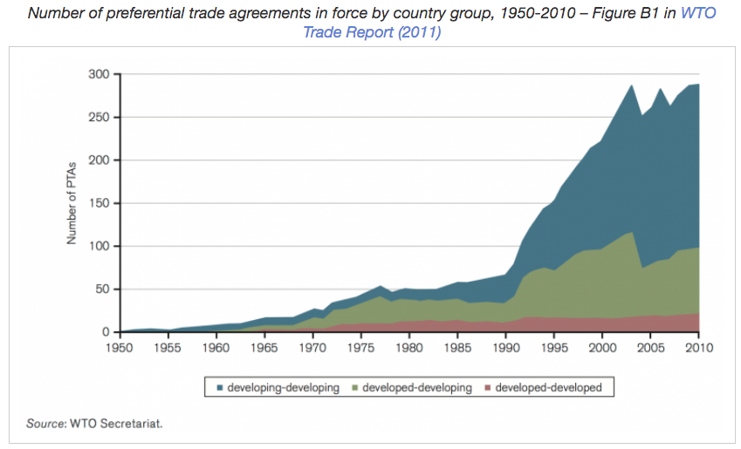
Notes:
Esteban Ortiz-Ospina and Max Roser (2018) - "International Trade". Published online at OurWorldInData.org.
Retrieved from: 'https://ourworldindata.org/international-trade' [Online Resource]

Slide 30
Policy Responses
Until recently
Efforts to encourage globalization
FTAs
Trans-Pacific Partnership
Under Trump
Tariffs on solar panels, washing machines, steel, aluminum
Tariffs on China
Retaliation by others

Slide 31
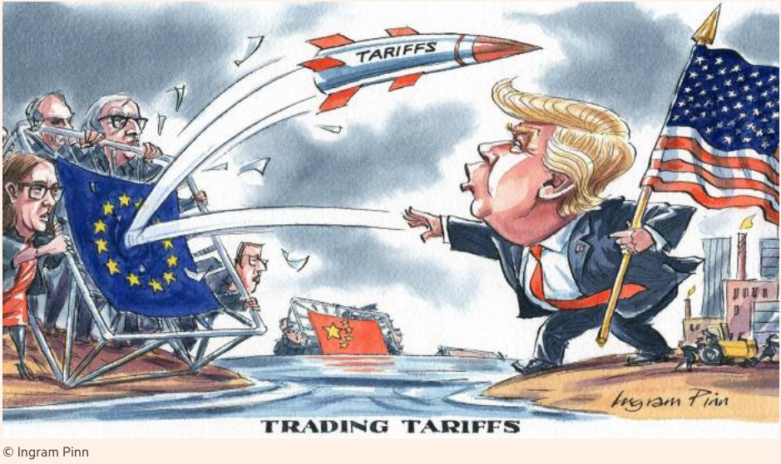
Notes:
https://www.ft.com/content/c56ebb64-7579-11e8-b326-75a27d27ea5f

